Slide 1
Unit – 3
Linear Data Structure
LINKED LISTS

Slide 2
INTRODUCTION
A linked list in simple terms is a linear collection of data elements. These data elements are called nodes.
Linked list is a data structure which in turn can be used to implement other data structures. Thus, it acts as building block to implement data structures like stacks, queues and their variations.
A linked list can be perceived as a train or a sequence of nodes in which each node contain one or more data fields and a pointer to the next node.
START
1
2
3
4
5
6
7
X
In the above linked list, every node contains two parts- one integer and the other a pointer to the next node. The left part of the node which contains data may include a simple data type, an array or a structure. The right part of the node contains a pointer to the next node (or address of the next node in sequence). The last node will have no next node connected to it, so it will store a special value called NULL.

Slide 3
INTRODUCTION contd.
Linked list contains a pointer variable, START which stores the address of the first node in the list.
We can traverse the entire list using a single pointer variable START. The START node will contain the address of the first node; the next part of the first node will in turn store the address of its succeeding node.
Using this technique the individual nodes of the list will form a chain of nodes. If START = NULL, this means that the linked list is empty and contains no nodes.
In C, we will implement a linked list using the following code:
struct node
{
int data;
struct node *next;
};

Slide 4
If we want to add a node to an already existing linked list in the memory, we will first find any free space in the memory and then use it to store the information.
The operating system maintains a free pool which is a linked list of a of all free memory cells. It maintains a pointer variable AVAIL which stores the address of the first free space.
When you delete a node from the linked list, the operating system adds the freed memory to the free pool.
The operating system will perform this operation whenever it finds the CPU idle or whenever the programs are falling short of memory. The operating system scans through all the memory cells and mark the cells that are being used by some or the other program. Then, it collects all those cells which are not being used and add their address to the free pool so that it can be reused by the programs. This process is called garbage collection. The whole process of collecting unused memory cells (garbage collection) is transparent to the programmer.
START
DATA | NEXT
H | 4
E | 7
L | 8
L | 10
O | -1
1
1 2 3 4 5 6 7 8 9 10
AVAIL
9
START pointing to the first element of the linked list in memory

Slide 5
Singly Linked List
void printList() {
struct node *ptr = start;
printf("\n[ ");
//start from the beginning
while(ptr != NULL)
{
printf("%d ",ptr->value);
ptr = ptr->next;
}
}
A singly linked list is the simplest type of linked list in which every node contains some data and a pointer to the next node of the same data type. By saying that the node contains a pointer to the next node we mean that the node stores the address of the next node in sequence.
START
1
2
3
4
5
6
7
X
Step 1: [INITIALIZE] SET PTR = START
Step 2: Repeat Steps 3 and 4 while PTR != NULL
Step 3: Print PTR->DATA
Step 4: SET PTR = PTR->NEXT
[END OF LOOP]
Step 5: EXIT
Algorithm for traversing a linked list

Slide 6
Inserting Node in the Linked List
1
7
3
4
2
6
5
X
START
START
9
1
7
3
4
2
6
5
X
Step 1: IF AVAIL = NULL, then
Write OVERFLOW
Go to Step 7
[END OF IF]
Step 2: SET New_Node = AVAIL
Step 3: SET New_Node->DATA = VAL
Step 4: SET New_Node->Next = START
Step 5: SET START = New_Node
Step 6: EXIT
Algorithm to insert a new node in the beginning of the linked list

Slide 7
1
7
3
4
2
6
5
X
START, PTR
1
7
3
4
2
6
5
9
X
START
PTR
Step 1: IF AVAIL = NULL, then
Write OVERFLOW
Go to Step 10
[END OF IF]
Step 2: SET New_Node = AVAIL
Step 3: SET New_Node->DATA = VAL
Step 4: SET New_Node->Next = NULL
Step 5: SET PTR = START
Step 6: Repeat Step 7 while PTR->NEXT != NULL
Step 7: SET PTR = PTR ->NEXT
[END OF LOOP]
Step 8: SET PTR->NEXT = New_Node
Step 9: EXIT
Algorithm to insert a new node at the end of the linked list

Slide 8
Step 1: IF AVAIL = NULL, then
Write OVERFLOW
Go to Step 12
[END OF IF]
Step 2: SET New_Node = AVAIL
Step 3: SET New_Node->DATA = VAL
Step 4: SET PTR = START
Step 5: SET PREPTR = START
Step 6: Repeat Step 7 and 8 while PREPTR->DATA != NUM
Step 7: SET PREPTR = PTR
Step 8: SET PTR = PTR->NEXT
[END OF LOOP]
Step 9: PREPTR->NEXT = New_Node
Step 10: SET New_Node->NEXT = PTR
Step 11: EXIT
Algorithm to insert a new node after a node (3) that has value NUM
1
7
3
4
2
6
5
X
START, PTR, PREPTR
1
7
3
4
2
6
5
X
START
PREPTR PTR
1
7
3
9
4
2
6
5
X
START

Slide 9
Deleting Node from the Linked List
Step 1: IF START = NULL, then
Write UNDERFLOW
Go to Step 5
[END OF IF]
Step 2: SET PTR = START
Step 3: SET START = START->NEXT
Step 4: FREE PTR
Step 5: EXIT
Algorithm to delete the first node from the linked list
START
1
7
3
4
2
6
5
X
START
7
3
4
2
6
5
X

Slide 10
Step 1: IF START = NULL, then
Write UNDERFLOW
Go to Step 8
[END OF IF]
Step 2: SET PTR = START
Step 3: Repeat Step 4 and 5 while PTR->NEXT != NULL
Step 4: SET PREPTR = PTR
Step 5: SET PTR = PTR->NEXT
[END OF LOOP]
Step 6: SET PREPTR->NEXT = NULL
Step 7: FREE PTR
Step 8: EXIT
Algorithm to delete the last node of the linked list
START, PREPTR, PTR
PREPTR PTR
1
7
3
4
2
6
5
X
START
1
7
3
4
2
6
X
5
X

Slide 11
Step 1: IF START = NULL, then
Write UNDERFLOW
Go to Step 10
[END OF IF]
Step 2: SET PTR = START
Step 3: SET PREPTR = START
Step 4: Repeat Step 5 and 6 while PRETR->DATA != NUM
Step 5: SET PREPTR = PTR
Step 6: SET PTR = PTR->NEXT
[END OF LOOP]
Step7: SET TEMP = PTR->NEXT
Step 8: SET PREPTR->NEXT = TEMP->NEXT
Step 9: FREE TEMP
Step 10: EXIT
Algorithm to delete the node after a given node from the linked list
1
7
3
4
2
6
5
X
START, PREPTR, PTR
1
7
3
4
2
6
5
X
START
PREPTR PTR
1
7
3
4
2
6
5
X
START
1
7
3
4
6
5
X
START

Slide 12
Algorithm to print the information stored in each node of the linked list
Step 1: [INITIALIZE] SET PTR = START
Step 2: Repeat Steps 3 and 4 while PTR != NULL
Step 3: Write PTR->DATA
Step 4: SET PTR = PTR->NEXT
[END OF LOOP]
Step 5: EXIT
Algorithm to print the number of nodes in the linked list
Step 1: [INITIALIZE] SET Count = 0
Step 2: [INITIALIZE] SET PTR = START
Step 3: Repeat Steps 4 and 5 while PTR != NULL
Step 4: SET Count = Count + 1
Step 5: SET PTR = PTR->NEXT
[END OF LOOP]
Step 6: EXIT

Slide 13
Algorithm to search an unsorted linked list
Step 1: [INITIALIZE] SET PTR = START
Step 2: Repeat Steps 3 while PTR != NULL
Step 3: IF VAL = PTR->DATA
SET POS = PTR
Go To Step 5
ELSE
SET PTR = PTR->NEXT
[END OF IF]
[END OF LOOP]
Step 4: SET POS = NULL
Step 5: EXIT
1
7
3
4
2
6
5
X
PTR
1
7
3
4
2
6
5
X
PTR
1
7
3
4
2
6
5
X
PTR
1
7
3
4
2
6
5
X
PTR

Slide 14

Doubly Linked List
A doubly linked list or a two way linked list is a more complex type of linked list which contains a pointer to the next as well as previous node in the sequence. Therefore, it consists of three parts and not just two. The three parts are data, a pointer to the next node and a pointer to the previous node
START
X
1
1
2
3
4
X
In C++ language, the structure of a doubly linked list is given as,
struct node
{ node *prev;
int data;
node *next;
};
The prev field of the first node and the next field of the last node will contain NULL. The prev field is used to store the address of the preceding node. This would enable to traverse the list in the backward direction as well.

Slide 15

Algorithm to insert a new node in the beginning of the doubly linked list
Step 1: IF Node_AVAIL = NULL, then
Write OVERFLOW
Go to Step 7
[END OF IF] //Allocate memory if available
Step 2: SET New_Node = Node_AVAIL
Step 3: SET New_Node->DATA = VAL
Step 4: SET New_Node->PREV = NULL
Step 5: SET New_Node->Next = START
Step 6: SET START = New_Node
Step 7: EXIT
X
1
7
3
4
2
X
START
X
9
1
7
3
4
2
X
START

Slide 16



Slide 17
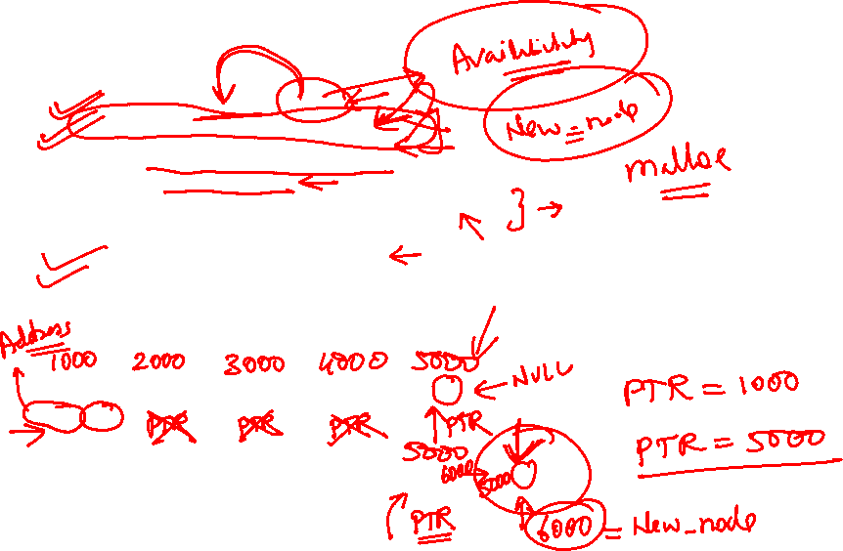
Algorithm to insert a new node at the end of the doubly linked list
Step 1: IF AVAIL = NULL, then
Write OVERFLOW
Go to Step 11
[END OF IF]
Step 2: SET New_Node = AVAIL
Step 3: SET AVAIL = AVAIL->NEXT
Step 4: SET New_Node->DATA = VAL
Step 5: SET New_Node->Next = NULL
Step 6: SET PTR = START
Step 7: Repeat Step 8 while PTR->NEXT != NULL
Step 8: SET PTR = PTR->NEXT
[END OF LOOP]
Step 9: SET PTR->NEXT = New_Node
Step 10: New_Node->PREV = PTR
Step 11: EXIT
X
1
7
3
4
2
X
START, PTR
X
1
7
3
4
2
9
X
START
PTR

Slide 18


Slide 19
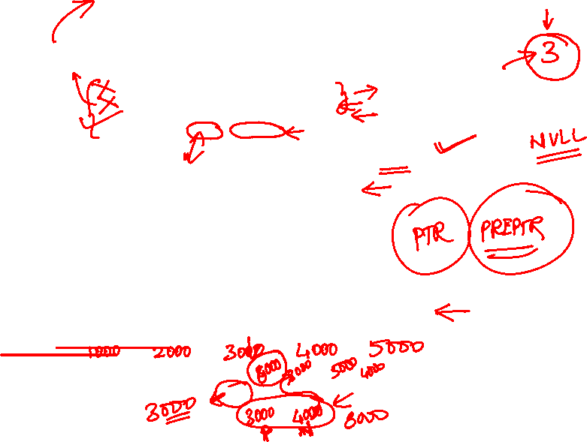
Algorithm to insert a new node after a node that has value NUM
Step 1: IF AVAIL = NULL, then
Write OVERFLOW
Go to Step 11
[END OF IF]
Step 2: SET New_Node = AVAIL
Step 3: SET AVAIL = AVAIL->NEXT
Step 4: SET New_Node->DATA = VAL
Step 5: SET PTR = START
Step 6: Repeat Step 8 while PTR->DATA != NUM
Step 7: SET PTR = PTR->NEXT
[END OF LOOP]
Step 8: New_Node->NEXT = PTR->NEXT
Step 9: SET New_Node->PREV = PTR
Step 10: SET PTR->NEXT = New_Node
Step 11: EXIT
X
1
7
3
4
2
X
START, PTR
X
1
7
3
4
2
X
START
PTR
9
X
1
7
3
9
4
2
X
START

Slide 20


Slide 21
Algorithm to delete the first node from the doubly linked list
Step 1: IF START = NULL, then
Write UNDERFLOW
Go to Step 6
[END OF IF]
Step 2: SET PTR = START
Step 3: SET START = START->NEXT
Step 4: SET START->PREV = NULL
Step 5: FREE PTR
Step 6: EXIT
X
1
7
3
4
2
X
START, PTR
7
3
4
2
X

Slide 23
Algorithm to delete the last node of the doubly linked list
Step 1: IF START = NULL, then
Write UNDERFLOW
Go to Step 7
[END OF IF]
Step 2: SET PTR = START
Step 3: Repeat Step 4 and 5 while PTR->NEXT != NULL
Step 4: SET PTR = PTR->NEXT
[END OF LOOP]
Step 5: SET PTR->PREV->NEXT = NULL
Step 6: FREE PTR
Step 7: EXIT
X
1
3
5
7
8
91
X
START, PTR
X
1
3
5
7
8
91
X
START
PTR
X
1
3
5
7
8
X
START

Slide 24
Algorithm to delete the node after a given node from the doubly linked list
Step 1: IF START = NULL, then
Write UNDERFLOW
Go to Step 9
[END OF IF]
Step 2: SET PTR = START
Step 3: Repeat Step 4 while PTR->next->DATA != NUM
Step 4: SET PTR = PTR->NEXT
[END OF LOOP]
Step 5: SET TEMP = PTR->NEXT
Step 6: SET PTR->NEXT = TEMP->NEXT
Step 7: SET TEMP->NEXT->PREV = PTR
Step 8: FREE TEMP
Step 9: EXIT
X
1
3
4
7
8
91
X
START, PTR
X
1
3
4
7
8
91
X
START
PTR
X
1
3
4
8
9
X
START

